Slide 1
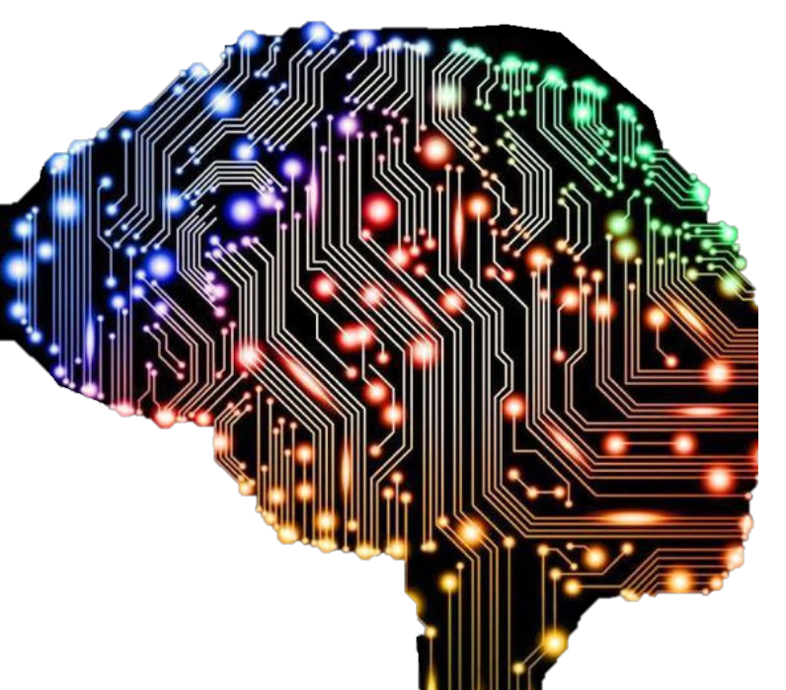
MSc Big Data Science Project
Paras Mani Gurung
Notes:
My Introduction

Slide 2
NepNet: Simple and efficient CNN model for Handwritten Devanagari Character recognition
Research on Devanagari character Recognition and Convolutional Neural Network
Notes:
My Project was based on research in Devanagari character recognition and convolutional neural network.

Slide 3
Motivation/Problem Definition
Not much of research conducted in the Devanagari Handwritten Character Recognition
Use of Acknowledged Deep CNN models results in heavy computing cost and memory usage

Slide 4
Project’s Aim
Build customised CNN model for recognition of the Devanagari handwritten characters
That uses a smaller number of parameters which reduces the computing cost, memory usage and storage space
Achieves higher test accuracy rate

Slide 5
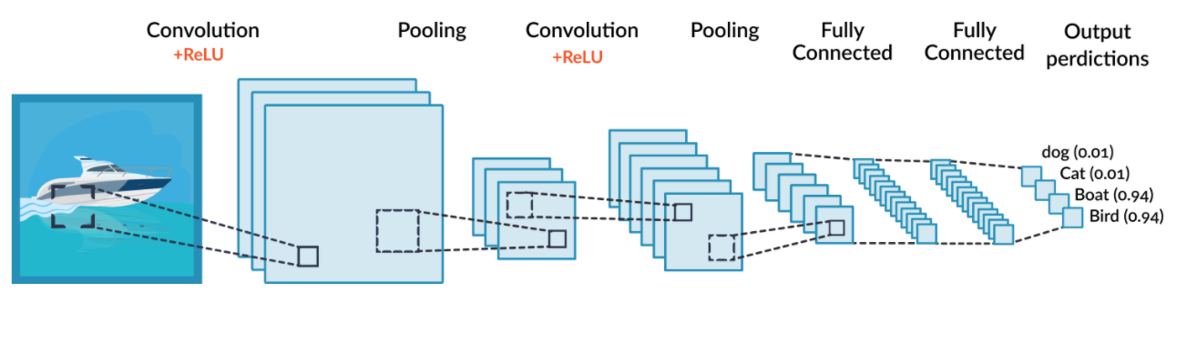
Convolutional Neural Network
CNN is a feed-forward neural network
Has achieved huge success in the field of large-scale image and video recognition
A simple CNN consists of convolution layers with activation function, pooling layers, fully connected layers and a classifier at the end.

Slide 6
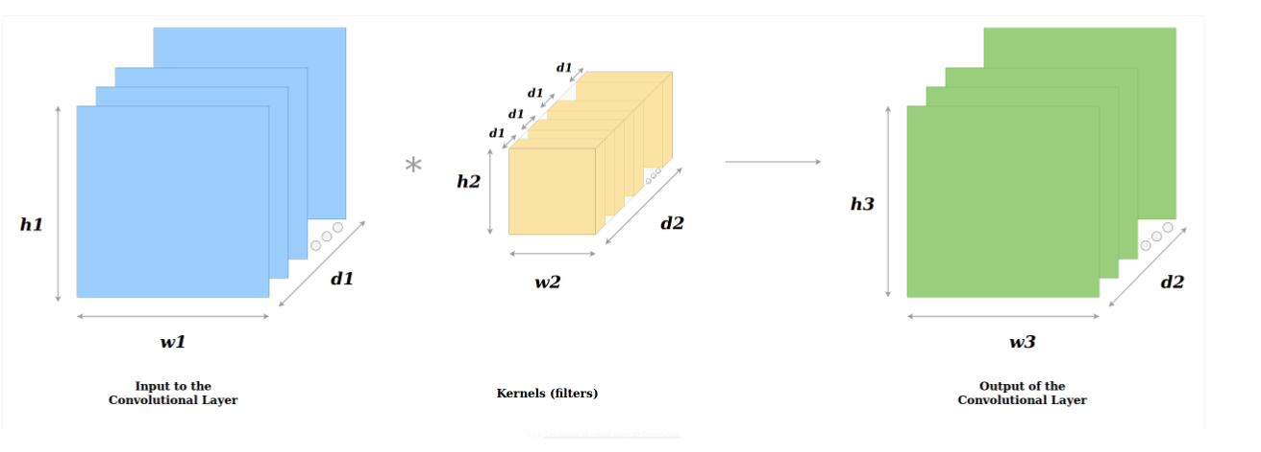
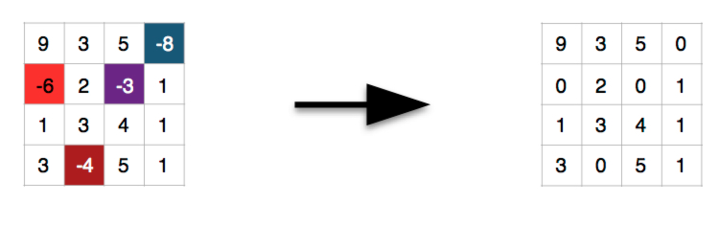
Convolutional Neural Network Cont.…
In a convolution layer, filters are applied to extract the relevant features from the input image and is passed to next layer in the network.
After every convolution operation activation function is applied.
Activation function is needed for using stochastic gradient descent with backpropagation of errors to train network.
Convolution Layer
ReLu- Activation function

Slide 7
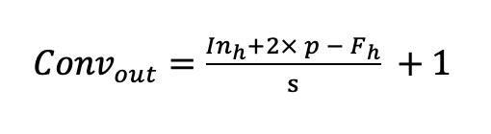
Convolutional Neural Network Cont.…
Calculation of the convolution output height or length of feature map, Conv_{out} from each convolutional layer of a CNN,
where In_{h} is the height or length of the input, p is the padding, F_{h} is the height or length of the filter and s is stride size.

Slide 8
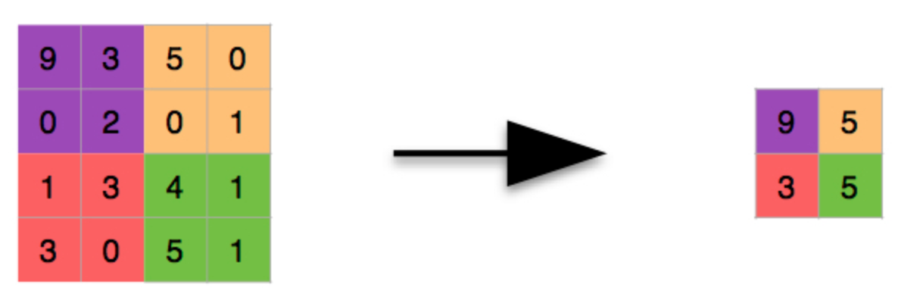
Convolutional Neural Network Cont.…
Pooling Layer
Also known as subsampling layer where the image size from the previous layer is reduced usually in half by keeping the highest value of a particular pixel area.
Max-Pooling

Slide 9
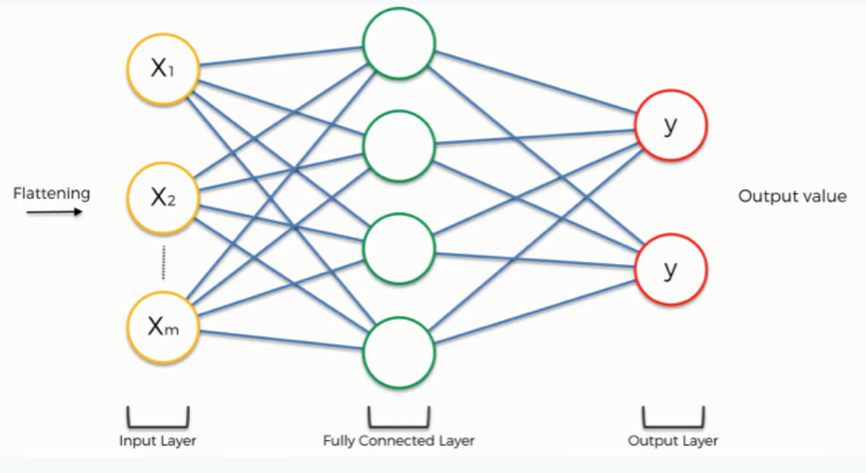
Convolutional Neural Network Cont.…
Fully Connected Layers
The final decision is made at the end this layer
The output from the final Pooling or Convolutional Layer is flattened and is input to the fully connected layer.

Slide 10
Convolutional Neural Network Cont.…
Calculating number of parameters in a CL
𝜌 = ω₊ 𝛽
𝜔 = ℱ_{h}× ℱ_{l} ×𝒞×𝒩
𝛽= 𝒩
𝜌= ℱ_{h}× ℱ_{l} ×𝒞×𝒩 + 𝒩
𝜌= 𝒩 (ℱ_{h}× ℱ_{l} ×𝒞 + 1)
where 𝜌 is the number of parameters, 𝜔 is the number of weights, 𝛽 is the number of bias, ℱ_{h} is the height of the filter, ℱ_{l} is the length of the filter, 𝒞 is the number of channels in the input and 𝒩 is the number of filters in the convolutional layer.

Slide 11
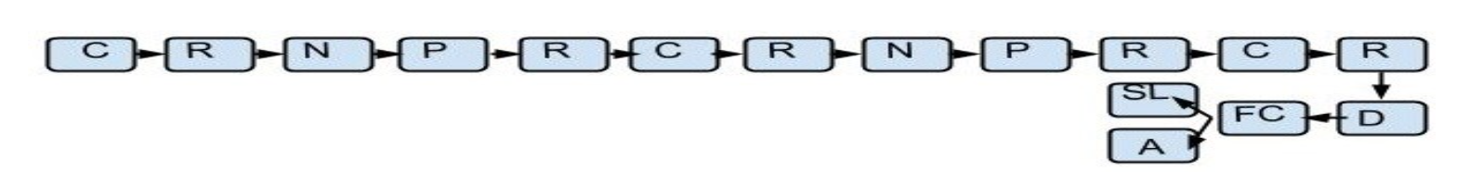
Previous Works
In 2015,
Sailesh and his team introduced the large Devanagari Handwritten Character Dataset i.e. UCI HDCD.
They were also able to achieve the test accuracy of 98.47% on the dataset.
Use of 5x5 filters in convolutional layers
Their CNN architecture

Slide 12
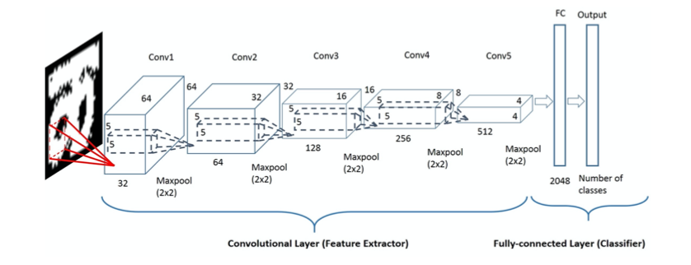
Previous Works Cont.…
In 2019, Riya and her team obtained the test accuracy of 99.54% on the dataset.
Their CNN architecture

Slide 13
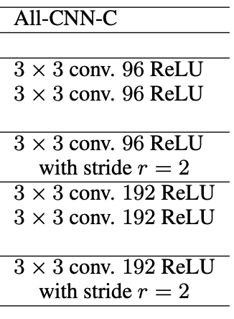
Previous Works Cont.…
Building efficient and light weight CNN architecture
Their CNN architecture
In 2014, Springenberg’s team published their work on the simplicity and the effectiveness of a network.
With very lesser number of parameters was able to surpass the state-of-the-art test accuracy on the CIFAR-10 dataset and obtained comparable results on the CIFAR-100 and ImageNet dataset

Slide 14
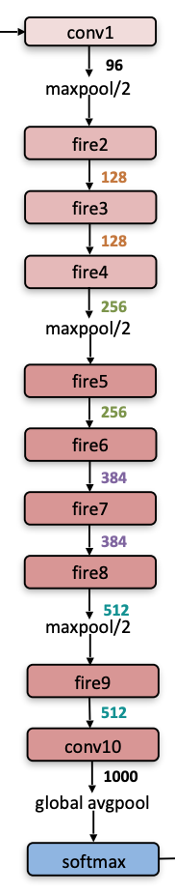
Previous Works Cont.…
Their CNN architecture
Building efficient and light weight CNN architecture
In 2016,
Iandola’s team introduced SqueezeNet which was able to achieve the AlexNet-level accuracy on ImageNet with 50 times fewer number of parameters.

Slide 15
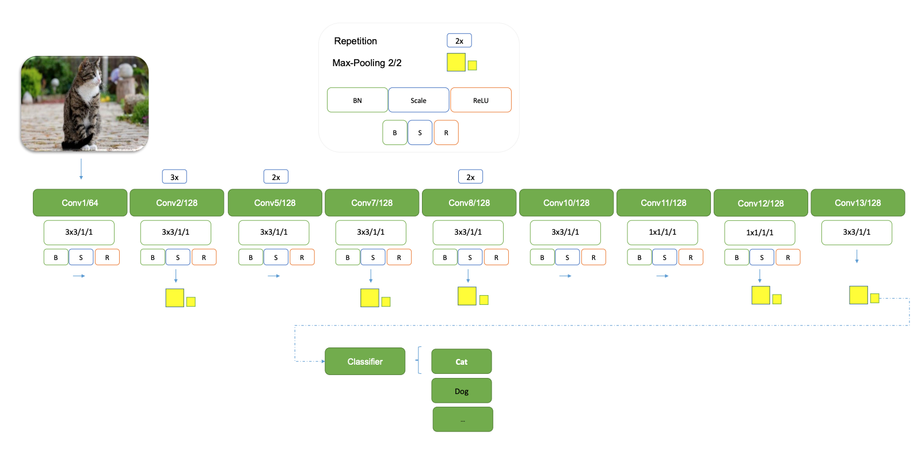
Previous Works Cont.…
Building efficient and light weight CNN architecture
In 2018, S.H. Hasanpour’s team introduced SimpleNet achieves state of the art result on CIFAR10 with 2 to 25 times fewer number of parameters and operations than the other deep CNN models.
Their CNN architecture

Slide 16
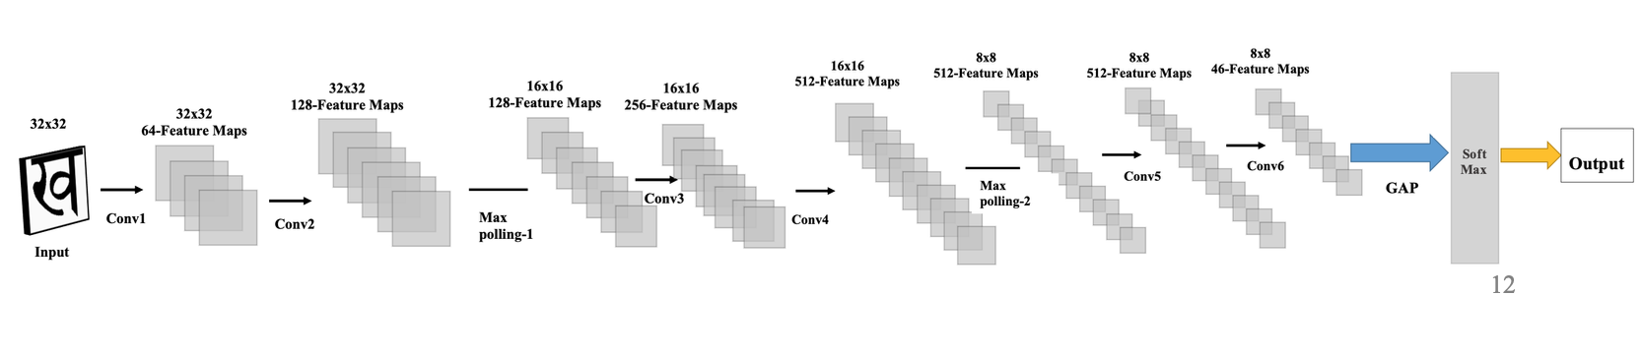
NepNet Architecture: Overview
NepNet CNN architecture
The first 4 CLs (convolution layers) uses 3x3 filters and the remaining 2 CLs uses 1x1 filters. 2 max-pooling is used one after 2nd CL and another after 4th CL.
After each convolution operation, BN (batched normalization) and activation function (ReLu) is being used. BN regularises the model.

Slide 17
NepNet Architecture Overview Cont.…
Layers | Architecture in detail
 | Filters | No. of filters | Padding | Strides
Conv-1 | 3x3 | 64 | Same | 1
Conv-2 | 3x3 | 128 | Same | 1
Max-Pooling | 2x2 |  |  | 2
Conv-3 | 3x3 | 256 | Same | 1
Conv-4 | 3x3 | 512 | Same | 1
Max-Pooling | 2x2 |  |  | 2
Conv-5 | 1x1 | 512 | Same | 1
Conv-6 | 1x1 | 512 | Same | 1
Global Average Pooling
Classification (SoftMax)
The number of filters is doubled from one layer to another until the fifth CL.
The max-polling uses the 2x2 filters with the stride of 2 which reduces the feature map’s size into half.

Slide 18
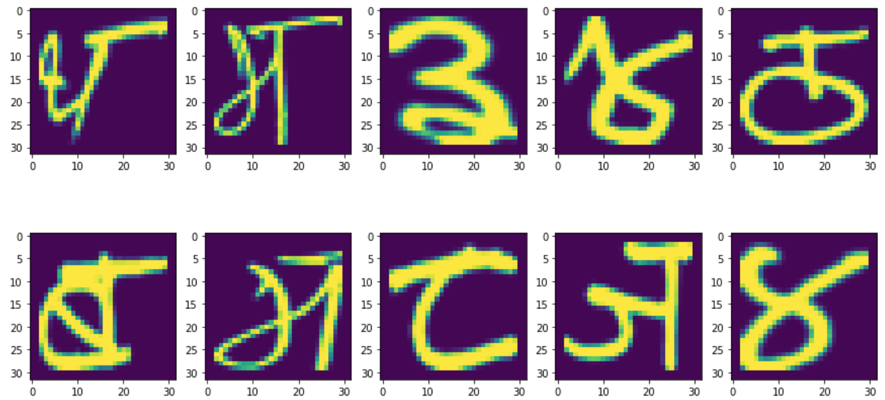
Dataset
The proposed CNN architecture, NepNet has been tested on the DHCD introduced by A.K. Pant ‘s team.
The dataset contains 92 thousand images of 46 different classes of Devanagari script 36 classes of consonant characters and 10 classes of numerals.
UCI Devanagari Handwritten Character Dataset
Training size | Validation size | Testing size
74290 | 3910 | 13800

Slide 19
Data Pre-processing
All the testing and training images are converted in the matrix format along with its class in arrays using the Python OpenCV library.
Both the training and test data are shuffled and saved by using Python pickle module.

Slide 20
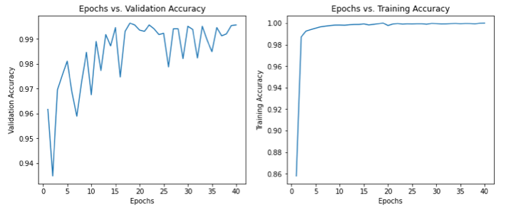
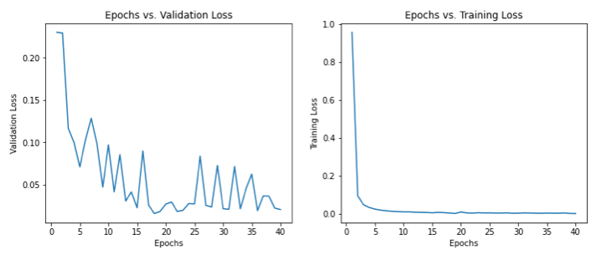
Result and Analysis
The proposed NepNet architecture obtained the test accuracy of 99.64% on the UCI HDCD (dataset).
Plotting of validation and training, accuracy and loss with number of epochs

Slide 21
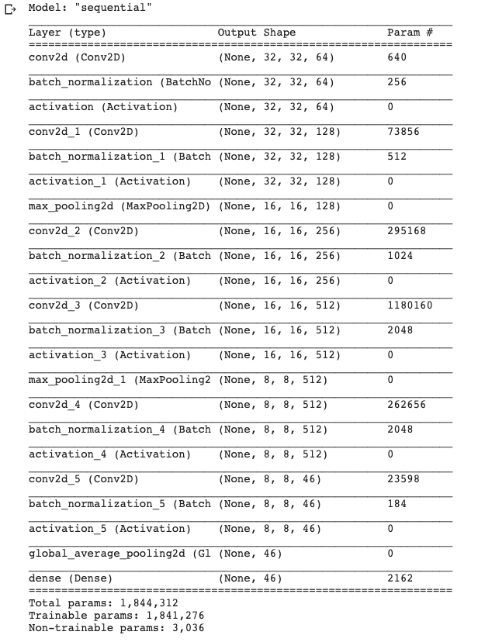
Result and Analysis Cont.…
Summary of parameters of the NepNet
Example of calculation numbers of parameters in a CL
In convolution layer-1:
height of the filter (ℱ_{h} ) = 3
length of the filter (ℱ_{l} ) = 3
number of filters (𝒩) = 64
number of channels in the input (𝒞) = 1
Now using the formula,
parameters, 𝜌= 𝒩 (ℱ_{h}× ℱ_{l} ×𝒞 + 1)
p= 64 (3 x 3 x 1 + 1)
p= 640
NepNet consists total of 1,841,276 trainable parameters

Slide 22
Result and Analysis Cont.…
Classification Accuracy and Error rate
Models | Accuracy (%) | parameters | Layers
LeNet-5 | 95.42 | ~0.7M | 7
ResNet-18 | 99.47 | ~11M | 18
ResNet-34 | 99.42 | ~21M | 34
AlexNet | 97.84 | ~61M | 8
DesnseNet-121 | 99.60 | ~7.9M | 121
Inception-v3 | 99.56 | ~26M | 42
A.K Pant et al. | 99.47 | ~2M | 3
DevNet (Riya Guha et al.) | 99.54 | ~4M | 5
Proposed Model (NepNet) | 99.62 | 1,841,276 | 6
Table shows comparison of Test Accuracy and number of parameter with other models on the dataset
We can see that with the lesser number of trainable parameters, NepNet has achieved the highest test accuracy rate.

Slide 23
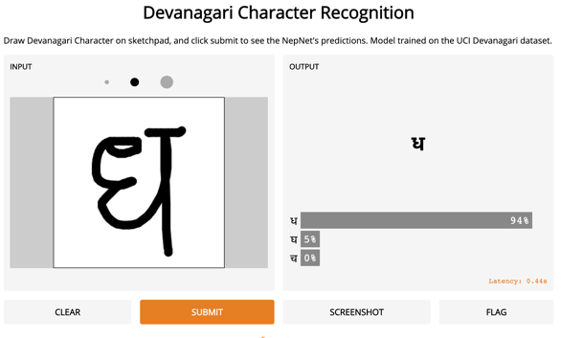
Development of NepNet based Applications
Character Recognition web system
Interface of the web system
Enables users to draw Devanagari characters
Predicts the drawn characters using NepNet
Developed by using Gradio library.

Slide 24
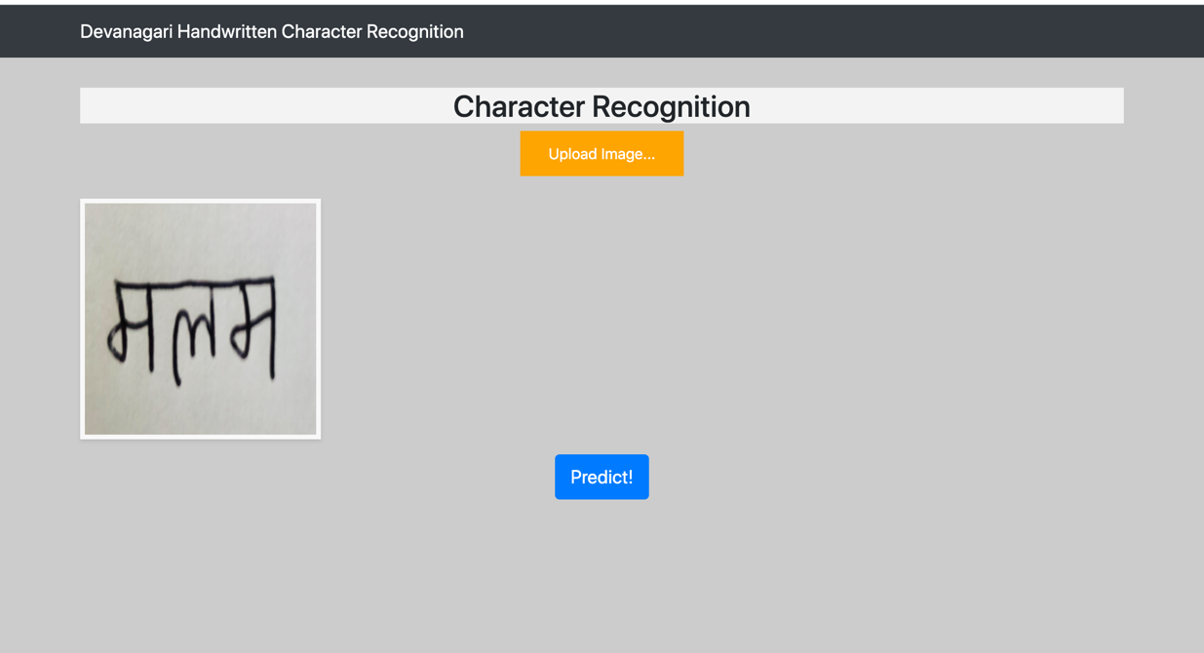
Development of NepNet based Applications Cont.…
Word Recognition web system
Interface of the web system
Enables users to upload image with Devanagari word
Predicts the word in the image using NepNet

Slide 25
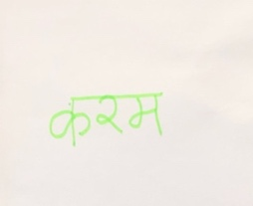
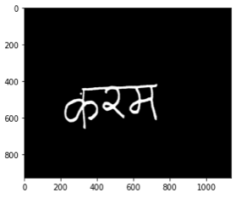
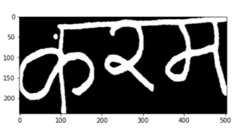
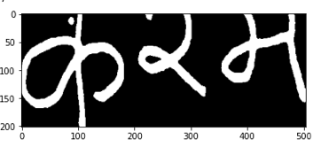
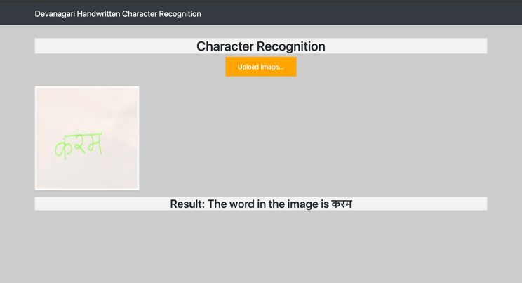
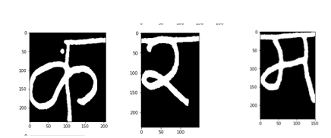
Development of NepNet based Applications Cont.…
Inside Word Recognition web system
Preprocessing
Localization
Dika removal
Input
Segmentation
NepNet for recognition
Output

Slide 26
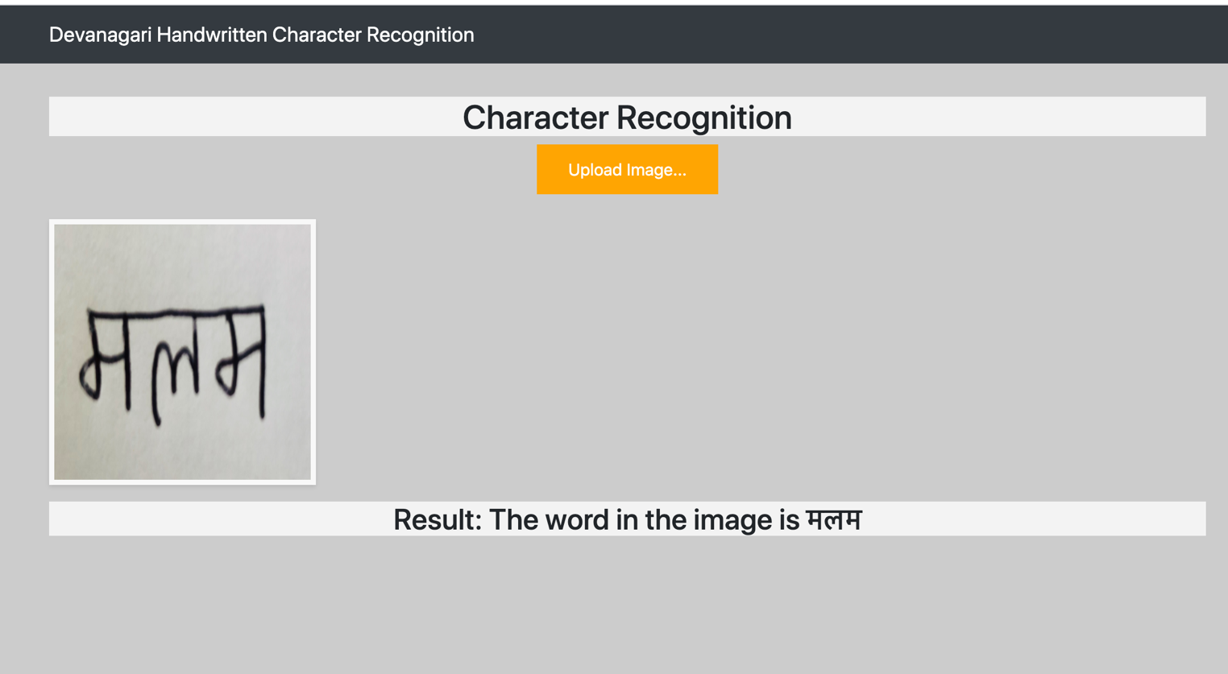
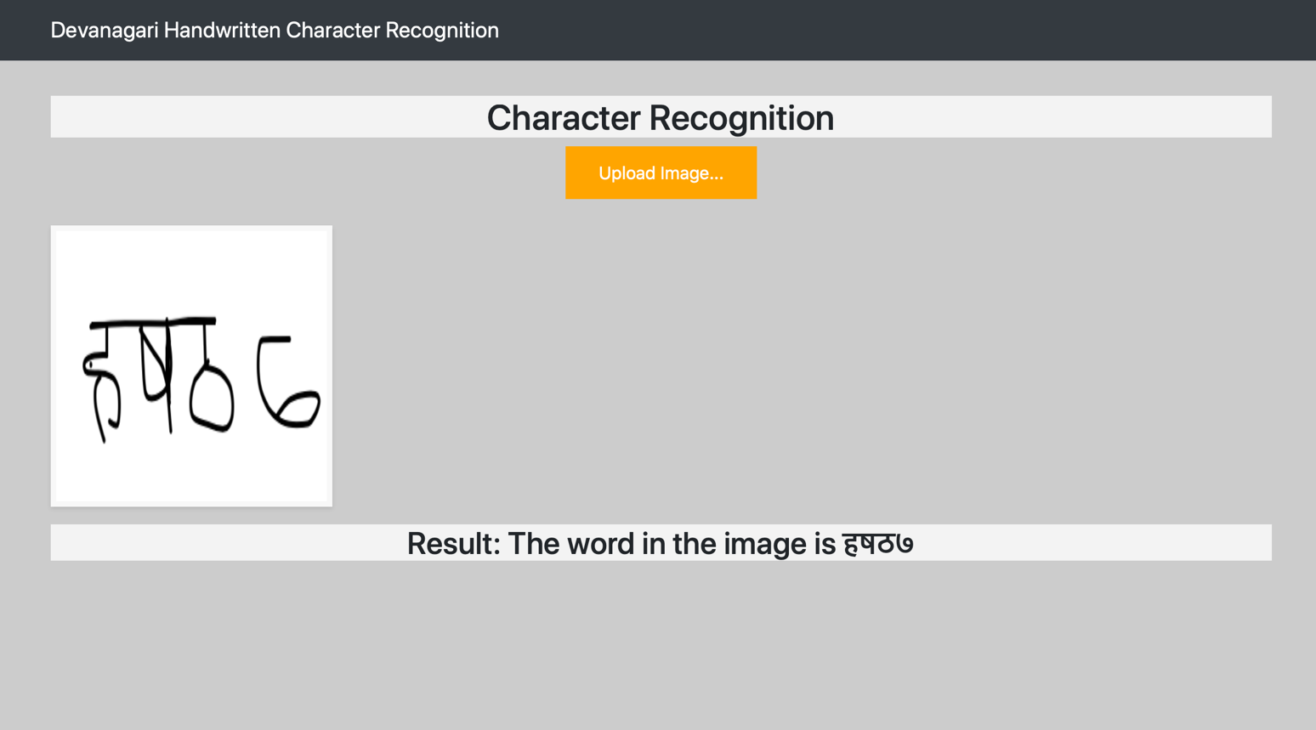
Development of NepNet based Applications Cont.…
Word Recognition web system
Examples of the word recognition

Slide 27
Evaluation of the Work
Strength /Highlight
The test accuracy obtained by NepNet 99.64% has surpassed all the model’s accuracy on the dataset.
With the fewer number of convolutional layers and trainable parameters, it has able to achieve such high-test accuracy on the dataset
The developed web application demonstrate how NepNet can be applied in the various applications.

Slide 28
Evaluation of the Work Cont.…
Weakness
The absence of Devanagari vowel characters in the used UCI Devanagari handwritten character dataset, has made the trained NepNet model incomplete.
The developed applications are just to demonstrate the efficiency and use of NepNet in a computer-vision based OCR system. However, they don’t have much practical use.

Slide 29
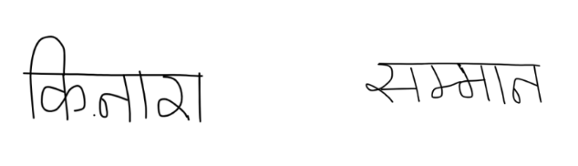
Further Work
Vowels Characters to be added to the dataset and train the NepNet on it.
Further research can be done in the segmentation of the words with half characters and vowels combined characters.
Then, extend the work from segmenting characters of a word to segmenting characters of paragraphs and a page.
Examples of word with half characters and combined characters

Slide 30
Legal, Social Ethical Issues and Sustainability
Legal Issue
Devanagari OCR applications are most likely to be operate in the countries, Nepal and India
Must be aware of Data Protection Act in those countries
The developed OCR applications must handle the data from the users with users consent and lawfully.

Slide 31
Legal, Social Ethical Issues and Sustainability Cont.…
Social Ethical Issue
People might question on the system’s error rate or accuracy on the task
It is very crucial to minimize the error rate of the developed application and promote effective of the system.

Slide 32
Legal, Social Ethical Issues and Sustainability Cont.…
Sustainability
Thee governments in Nepal and most states of India has recently planned to move to paperless administration.
Character recognition system is still fresh subject for Devanagari script

Slide 33

Thank You For Your Time

Slide 34
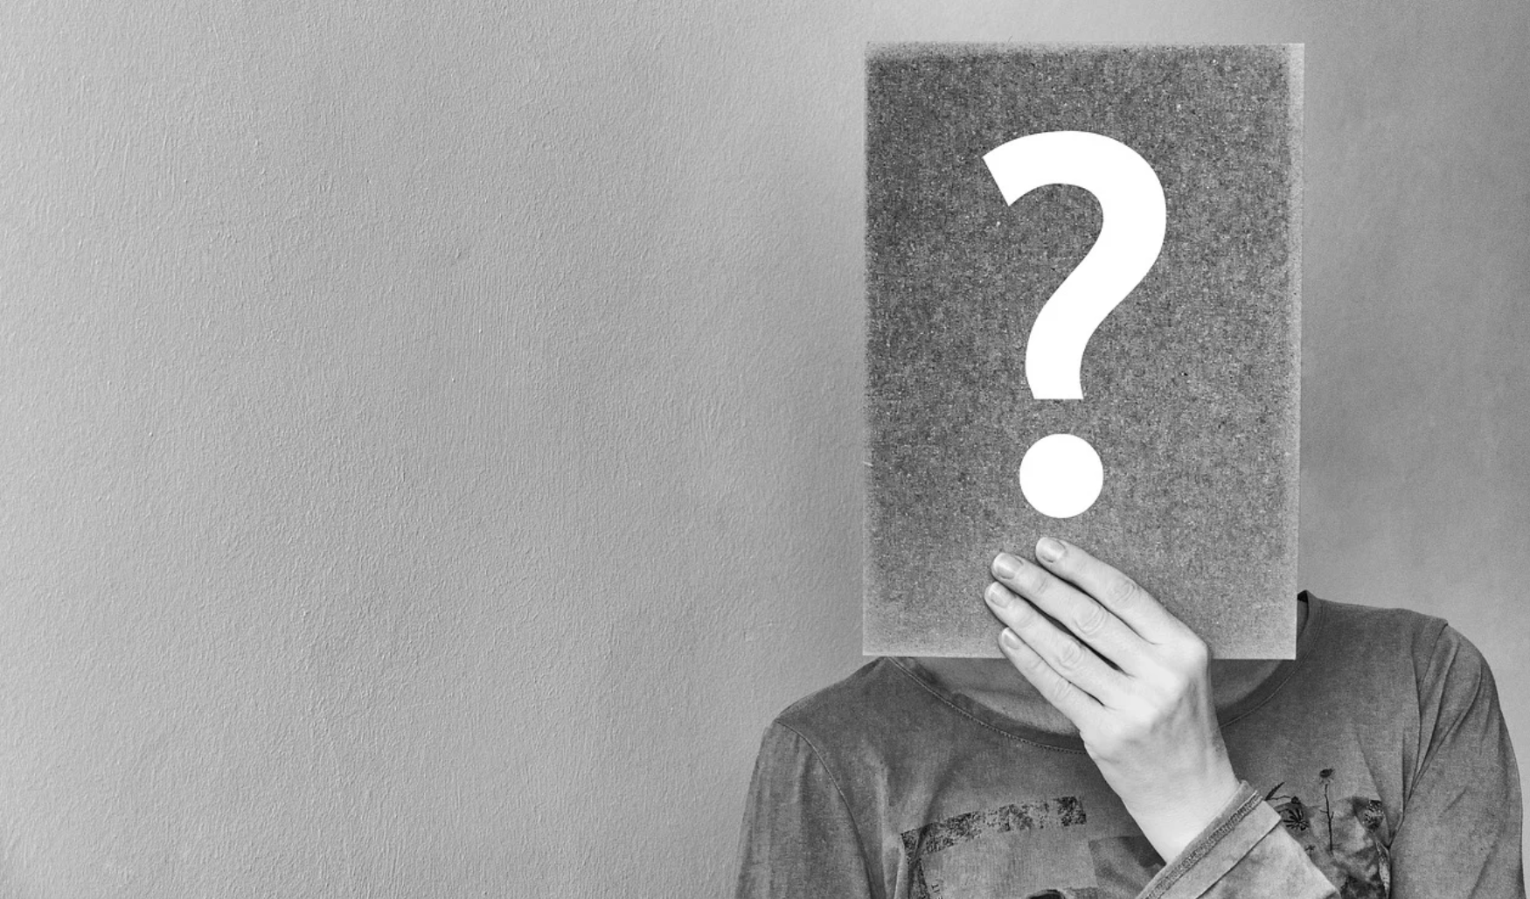
Any Questions

